Slide 1
SCRUM
Trener: Krzysztof Majewski
Szczecin, 18.11.2018

Slide 2
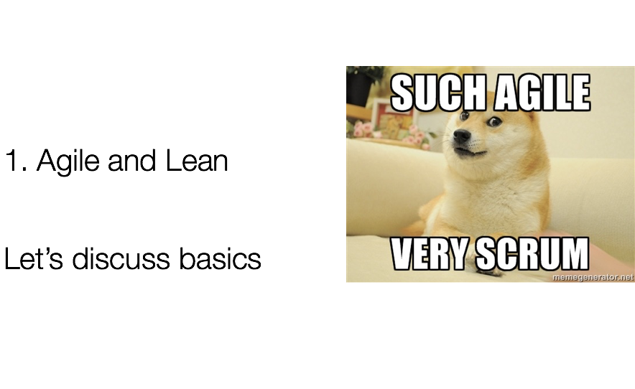

Slide 3
The Agile Manifesto
Agile Alliance – unformal group of independent software professionals who met on February 11-13, 2001 at ski resort in the Wasatch mountains of Utah.
During the meeting those 17 „lightweight methodologists” found common ground and signed a Manifesto for Agile Software Development

Slide 4
The Agile Manifesto
Individuals and interactions over processes and tools
Working software over comprehensive documentation
Customer collaboration over contract negotiation
Responding to change over following a plan

Slide 5
The Agile Manifesto - Principles
Our highest priority is to satisfy the customer
through early and continuous delivery
of valuable software.
Welcome changing requirements, even late in
development. Agile processes harness change for
the customer's competitive advantage.

Slide 6
The Agile Manifesto - Principles
Deliver working software frequently, from a
couple of weeks to a couple of months, with a
preference to the shorter timescale.
Business people and developers must work
together daily throughout the project.

Slide 7
The Agile Manifesto - Principles
Build projects around motivated individuals.
Give them the environment and support they need,
and trust them to get the job done.
The most efficient and effective method of
conveying information to and within a development
team is face-to-face conversation.

Slide 8
The Agile Manifesto - Principles
Working software is the primary measure of progress.
Agile processes promote sustainable development.
The sponsors, developers, and users should be able
to maintain a constant pace indefinitely.
Continuous attention to technical excellence
and good design enhances agility.

Slide 9
The Agile Manifesto - Principles
Simplicity--the art of maximizing the amount
of work not done--is essential.
The best architectures, requirements, and designs
emerge from self-organizing teams.
At regular intervals, the team reflects on how
to become more effective, then tunes and adjusts
its behavior accordingly.

Slide 10
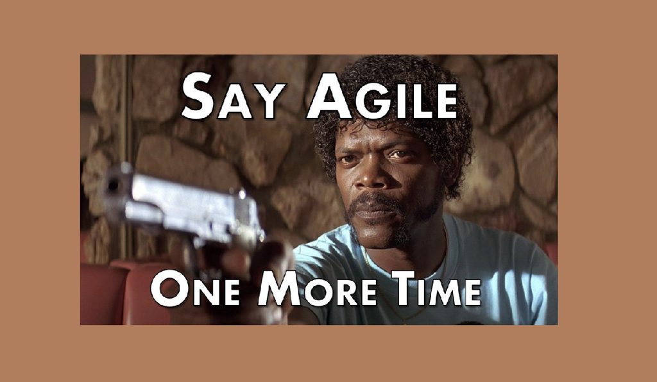

Slide 11

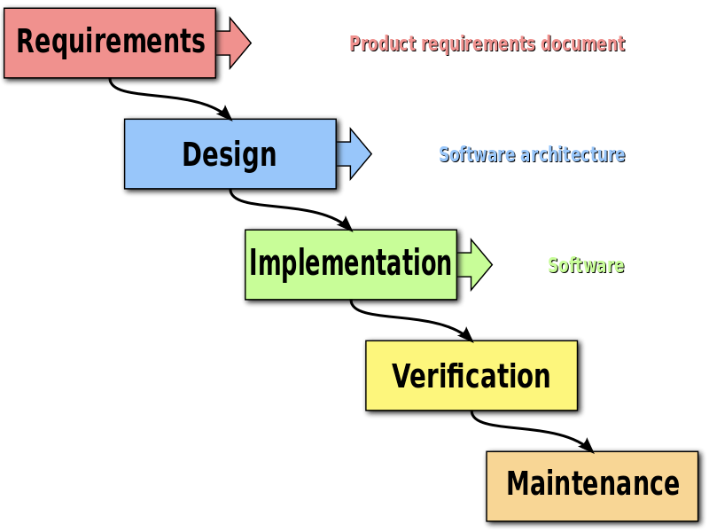
Waterfall vs Agile

Slide 12
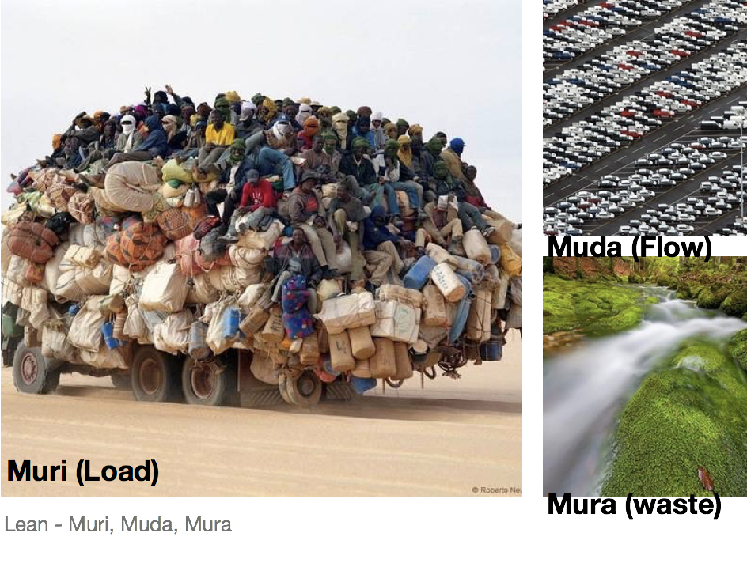

Slide 13
Lean Concepts
Muri - The concept of not overloading processes.
Muda - The concept of keeping the flow smooth and even.
Mura - The concept of removing the Non-Value adding activities.

Slide 14
Lean Principles
Eliminate Waste
Build Quality In
Create Knowledge
Defer commitment
Respect People
Optimize the Whole
Deliver as fast as possible

Slide 15
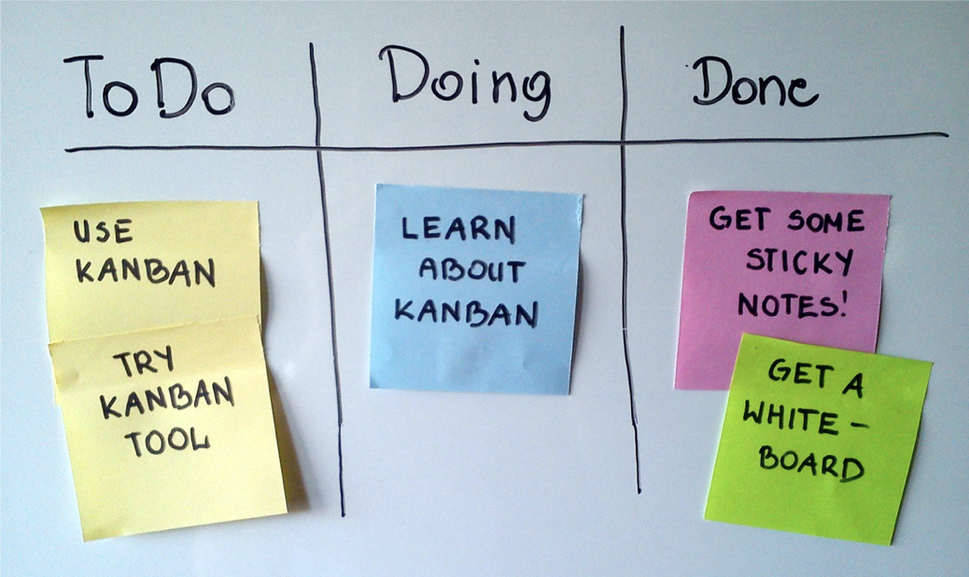
Kanban

Slide 16
Kanban rules
No deficiencies.
No delays.
No stockpiling.
No queues as no one can be idle at any stage of the production process.
No unnecessary technological operations nor control ones.

Slide 17
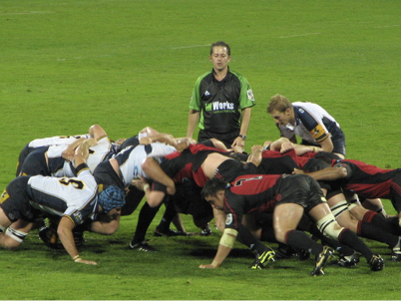
What is SCRUM?
Not only a rugby term

Slide 18
What is SCRUM?
Scrum is a simple framework used to organize teams and get work done more productively with higher quality.

Slide 19
What is SCRUM?
The term itself (“Scrum”) was introduced by Takeuchi and Nonaka (1986). The study was published in Harvard Business Review in 1986. They explain that projects using small, cross-functional teams historically produce the best results. They relate these high performance teams to “Scrum” formations in Rugby.
Scrum for software development was introduced in 1993

Slide 20
Scrum characteristics
Teams can choose the amount of work to do in one iteration and how to best fulfill the agreed goal.
Focus on prioritizing the work based on Business Value, improving the customer satisfaction by releasing what is needed and at the right time.
Allow to adapt to changing requirements at regular short intervals without big impact on the product development.
Allow to deliver working software at regular intervals.

Slide 21
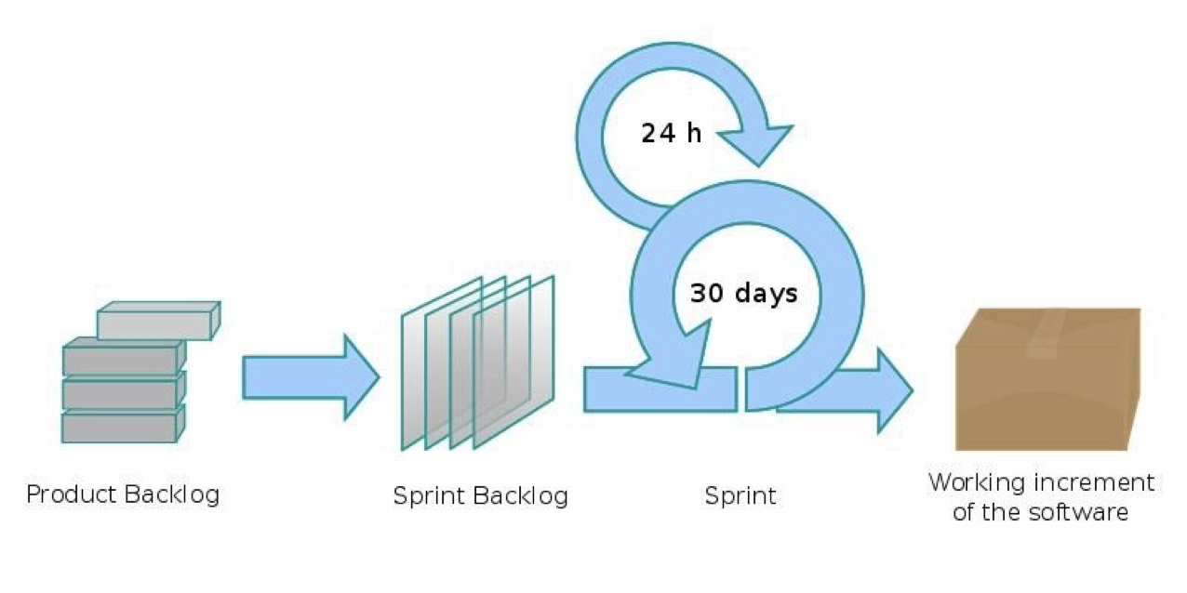
Scrum characteristics

Slide 22
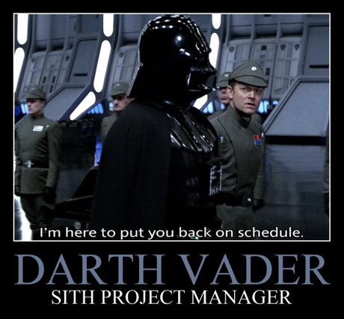
SCRUM Roles

Slide 23
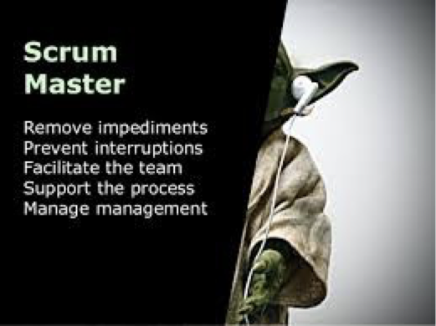
Scrum Master
Master-Servant for the team. Leads and coaches but also removes all obstacles and impediments from the road ahead.
Facilitates all SCRUM ceremonies.
Improves processes in the team(s) and organisation.

Slide 24
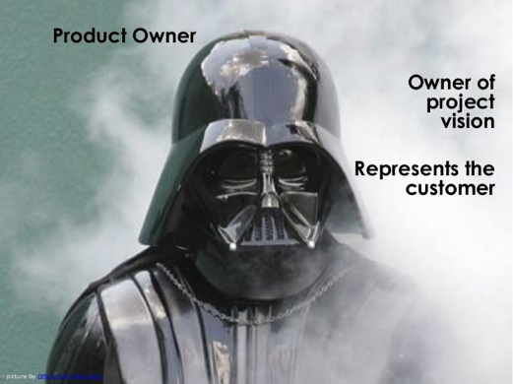
Product Owner
Owns the Product Backlog.
Owns the business side of the project/product.
Owns the project vision.
Responsible for gathering stakeholders needs and expectations and translating them into stories/tasks.

Slide 25

The Team
Self-organising entity composed of 3-10 people (typically 5-9).
Interdisciplinary, cross-functional group of professionals.
They do the work necessary for delivering a potentially releasable increment that fulfils the “Done” definition.

Slide 26

Tuckmans group development stages
Forming
Storming
Norming
Performing

Slide 27

SCRUM Ceremonies
Not only stand-ups.

Slide 28
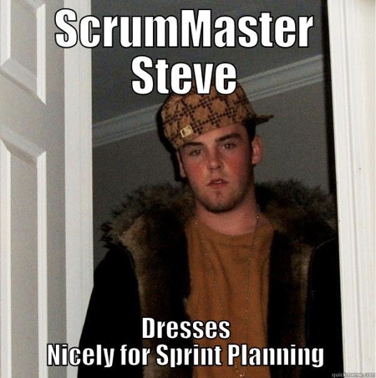
Planning
Communicates the scope of work that will likely be done during a sprint.

Slide 29

Daily stand-ups
Time boxed to 15 minutes.
Answer 3 questions:
1. What did I do yesterday?
2. What do I plan to do today?
3. Is there anything blocking me from obtaining my goals?

Slide 30
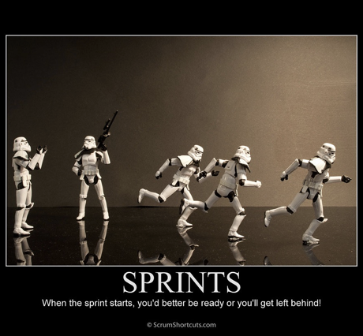
Sprints
Time interval that is used by the team to deliver increments.

Slide 31
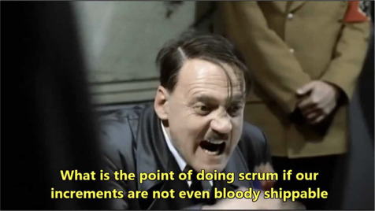
Sprint Reviews
Summary of what’s been done (and what hasn’t) in the sprint that’d ended.

Slide 32
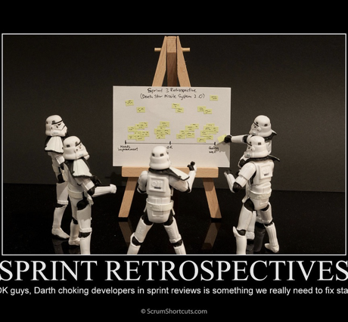
Sprint Retrospectives
Meeting that allows to improve the quality of delivered work.

Slide 33

Scrum of Scrums
Meeting that allows to coordinate work between the Scrum teams.

Slide 34
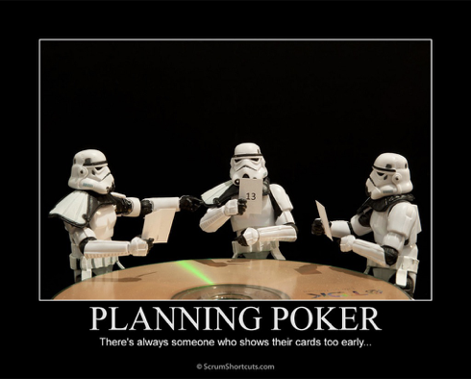
Backlog Refinement/Grooming
Meeting that allows to keep the Backlog tidy and up-to-date.

Slide 35
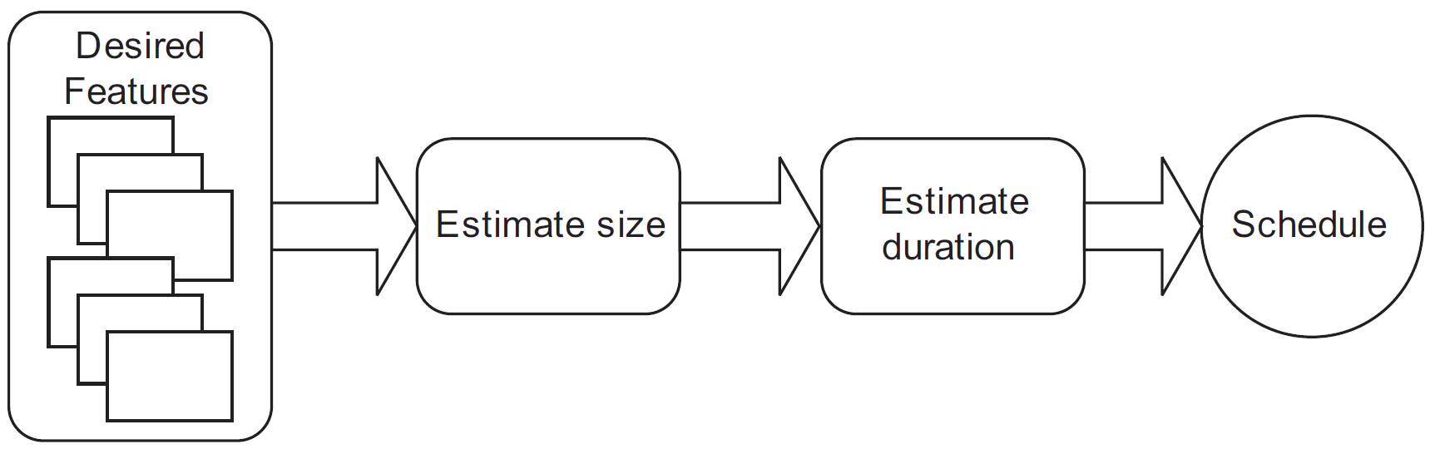
Estimating

Slide 36
Estimating
Story points are a unit of measure for expressing the overall size of a user story, feature, or other piece of work.
Ideal days are the imaginable amount of time that would be spent on the project if there were no interruptions (including email checking), everybody was working full time at full speed without any vacations and everything needed was present from the day one
T-shirt sizes are easy to comprehend (as we all buy clothes) but harder to count if a team wants to know its velocity.

Slide 37
Estimating - velocity
Velocity is a measure of a team’s rate of progress. It is calculated by summing the number of story points (or ideal days) assigned to each user story that the team completed during the iteration.

Slide 38
Planning poker
All team members should participate (PO does not estimate)
1. Each estimator is given a deck of cards that read 0, 1, 2, 3, 5, 8, 13, 20, 40, 100 2. Each user story is read and clarified by team and PO
3. Each estimator privately selects a card representing estimate
4. All cards are simultaneously turned over
5. If estimates differ, the high and low estimators explain their estimates and story can be estimated once again

Slide 39
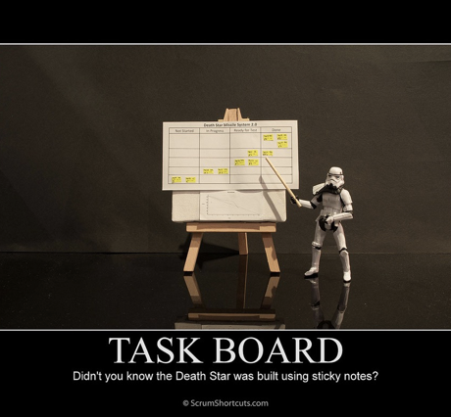
SCRUM Artifacts
Backlog and stuff.

Slide 40
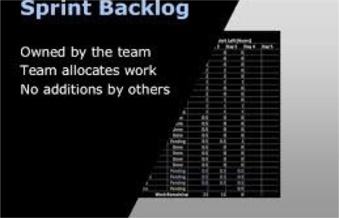
Sprint Backlog
Place of storing for team’s commitment for a sprint.

Slide 41
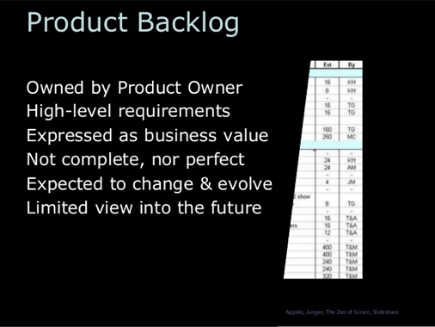
Product Backlog
Stores Product Owner’s requirements for project/product.

Slide 42
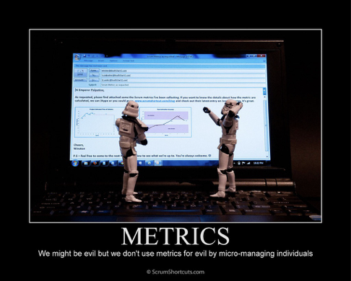
Metrics
Product Increment, Sprint Burn-Down Chart, Release Burn-Down Chart.

Slide 43
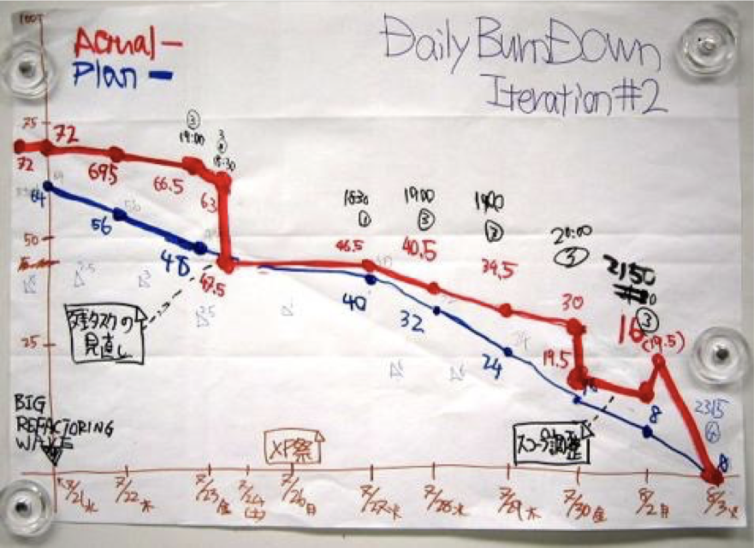
Burndown chart

Slide 44
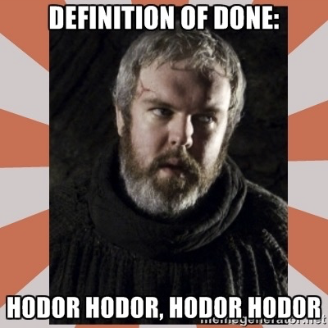
Definition of Done
What constitutes “Done” for the incrementation.

Slide 45
User story
User story is a brief description of functionality as viewed by a user or customer of the system:
As a <type of user>, I want <capability> so that <business value>

Slide 46
I.N.V.E.S.T. in your stories!
• Independent
• Negotiable
• Valuable
• Estimable
• Sized appropriately
• Testable

Slide 47

Acceptance criteria
Acceptance Criteria are the requirements that have to be met for a story to be assessed as complete.

Slide 48
Acceptance criteria
They are incredibly important in Scrum because they spell out what a Product Owner expects and what a team needs to accomplish.
There are no hairs to split and no points to argue. If it’s in the acceptance criteria, then it needs to be in the release.

Slide 49

Effective SCRUM
What to do and what - not.

Slide 50
Be a Tragic SCRUM Participant
Don’t care about Scrum - it’s only boring stand-ups.
Don’t care about what you do - someone will tell
you eventually.
Don’t care about the product
Be a lone wolf.
Don’t care about your teammates.
F**k the effectiveness.
Be passive.
Stall your work.
Take everything for granted.
Micromanage everyone’s else’s work.
Be irreplaceable.
Don’t improve - the process is sacred.

Slide 51
Be a Perfect SCRUM Participant
Know exactly what Scrum is and is not.
Know exactly what you should do and what you should not.
Have a strong sense of responsibility and high self-esteem.
Have good teamwork skills.
Care for your teammates.
Work as effectively as you can.
Be active and proactive.
Do not procrastinate.
Doubt and ask.
Self-organise.
Be replaceable.
Improve.

Slide 52
Dziękuję za uwagę

